Slide 1
AUTOSAR Adaptive Platform
by chinh.nguyen

Slide 2
Contents
What is AUTOSAR?
AUTOSAR in Vehicle Network
AUTOSAR Adaptive platform
Architecture & Interface
Methodology

Slide 3
1. What is AUTOSAR?
AUTOSAR: AUTomotive Open System Architecture
Mission: AUTOSAR is a global partnership of leading companies in the automotive and software industry to develop and establish the standardized software framework and open E/E system architecture for intelligent mobility.
Vision: AUTOSAR will be the global established standard for software and methodology enabling open E/E system architectures for future intelligent mobility supporting high levels of dependability, especially safety and security.

Slide 4

1. What is AUTOSAR? - Partnership

Slide 5
1. What is AUTOSAR? - Main goals
Creation of Software that are widely Independent of Hardware, that allows reusability.
Reduce the Development time and the time to Market.
Reuse of the software to enhance the quality and the efficiency of the software.
Notes:
Reuse of SW in multiple HW platform
…by decoupling the Development Activities for parallel development with different functional domains: POWER TRAIN, ACTIVE/PASSIVE SAFETY, HUMAN MACHINE INTERFACE, BODY & COMFORT, TELEMATICS, CHASSIS.
SW could be portable in vehicles of different manufactures & the electronic component of suppliers

Slide 6
1. What is AUTOSAR? - Main working topics
Architecture
Methodology
Application Interface
Notes:
Architecture: Provides a structured platform for HW independent SW application with the help of Autosar Basic Software (BSW) Stack or AUTOSAR Runtime for Adaptive Applications (ARA).
Methodology: Define data exchange formats or description template to enable a seamless configuration process of BSW Stack, ARA.
Application Interface: Provides standard Specification of Interfaces of Automotive applications from all domains in term of Syntax and Semantics.

Slide 7
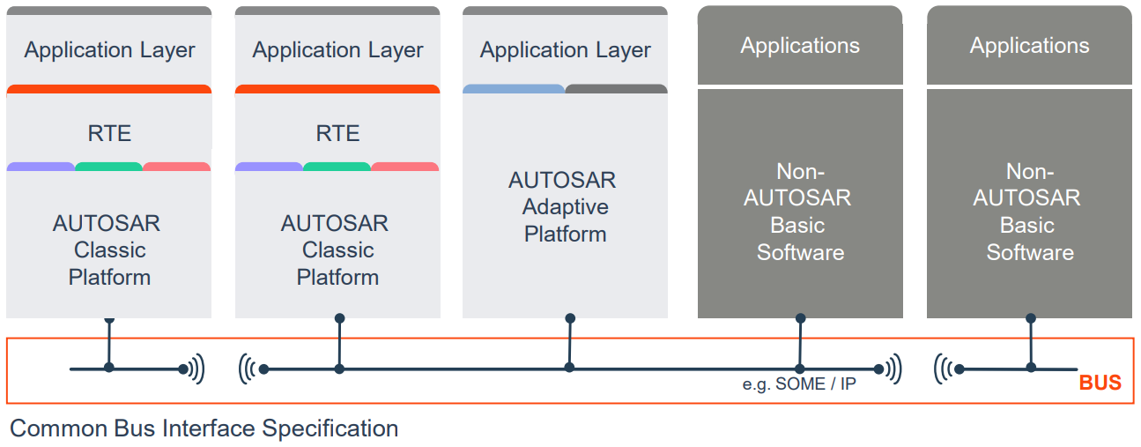
2. Autosar in Vehicle Network

Slide 8
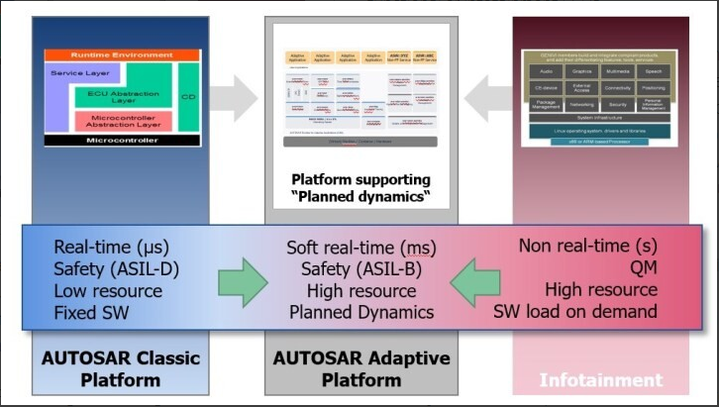
2. Autosar in Vehicle Network

Slide 9
2. Autosar in Vehicle Network - AUTOSAR Platform Comparison
Goal or Feature | Classic Platform | Adaptive Platform
Use cases | Embedded systems | High performance computing, communication with external resources, and flexible deployment
Programming language | C | C++
Operating system | based on OSEK | based on POSIX
Real-time requirements | Hard(µS) | Soft(mS)
Computing power | Low | High
Communication | Signal-based BUS network: CAN, LIN, etc. | Event-based, service-oriented Ethernet and SOME/IP
Safety and security | Supported ASIL-D | Supported ASIL-B
Dynamic updating | Not available | Incremental deployment and run-time configuration changes
Level of standardization | High-detailed specifications | Low-APIs and semantics
Agile development | No | Yes

Slide 10
3. Autosar Adaptive platform
The Adaptive Platform is a distributed computing and service-oriented architecture (SOA).
The platform provides high-performance computing, message-based communication mechanisms, and flexible software configuration for supporting applications, such as automated driving and infotainment systems.
Notes:
AUTOSAR Adaptive architecture that can support dynamic communication, a flexible and secure platform, faster data communication and processing, and more.
Adaptive AUTOSAR’s flexible integration environment enhances the capability of the software to be updated and extended with new features.

Slide 11
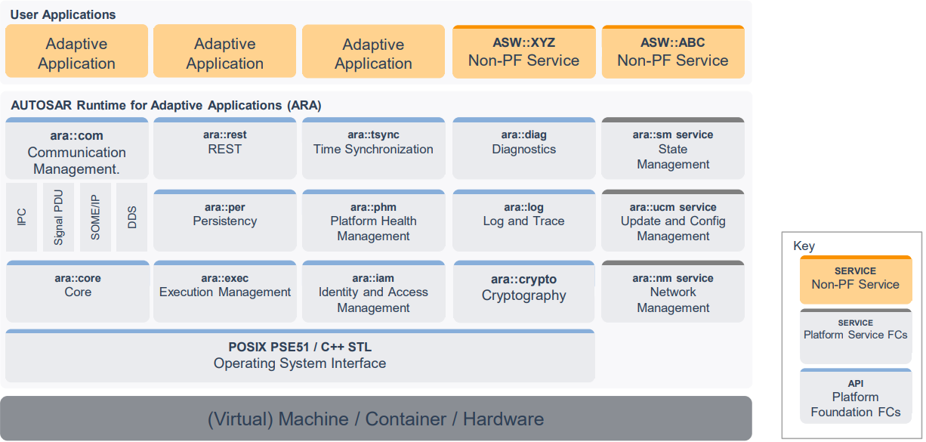
3. Autosar Adaptive platform - Architecture & Interface - Logical view
Notes:
AUTOSAR Adaptive Platform implements the AUTOSAR Runtime for Adaptive Applications (ARA)
ARA provide services and APIs for AA.
ARA = application interfaces
AA(Adaptive Applications) = run on top of ARA & provide nonplatform service for other AA
Adaptive Platform Foundation = fundamental functionalities of AP
Adaptive Platform Services = platform standard services of AP

Slide 12
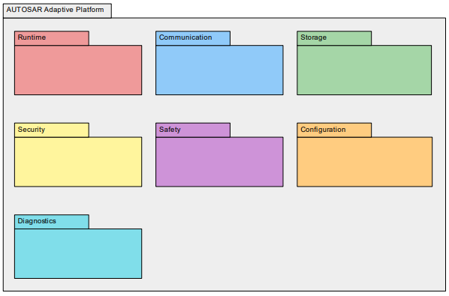
3. Autosar Adaptive platform - Architecture & Interface - Building block view
Notes:
- overview of the static structure of the AUTOSAR Adaptive Platform by describing the high-level building blocks

Slide 13
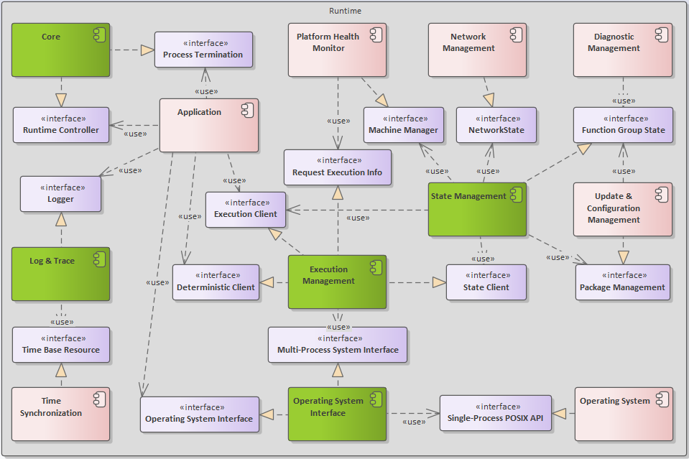
3. Autosar Adaptive platform - Architecture & Interface - Building block view - Runtime
Notes:
EM: manages the Lifecycles, Loading, Launching of AA. EM launch AA with configuration at system integration time or at runtime.
Deterministic Client: run a cyclic deterministic execution.
Execution Client: AA & SM use to report execution state.
State Client: SM us to request transitions to Function Group State.
Request Execution Info: retrieve information about Processes and Function Group States.
SM: determines the desired target state of the ARA based on various application-specific inputs, EM switch state of AA to those state.
Network State: use to trigger activation and deactivation of (partial) networks and to subscribe for corresponding activation and deactivation events.
Package Management: use to subscribe for status changes of UCM. OS: responsible for runtime scheduling of the Process of AA.
Log & Trace: provides functionality to build and log messages of different severity.
Time Base Resource: used to determine timestamps for log messages.
Logger: AA use to log textual messages.
Operating System Interface: provides functionality for implementing multi-threaded real-time embedded applications and corresponds to the [9, POSIX PSE51 profile].
Multi-Process System Interface: use to starting, controlling, and stopping Processes via the Operating System.
Operating System Interface: create, configure and control multiple Threads with support for real-time guarantees.
Core: provides runtime control functionality: initialization and de-initialization of the AA as well as termination of Processes.
Runtime Controller: initialization and de-initialization of the AA.
Process Termination: to terminate the current Process.

Slide 14
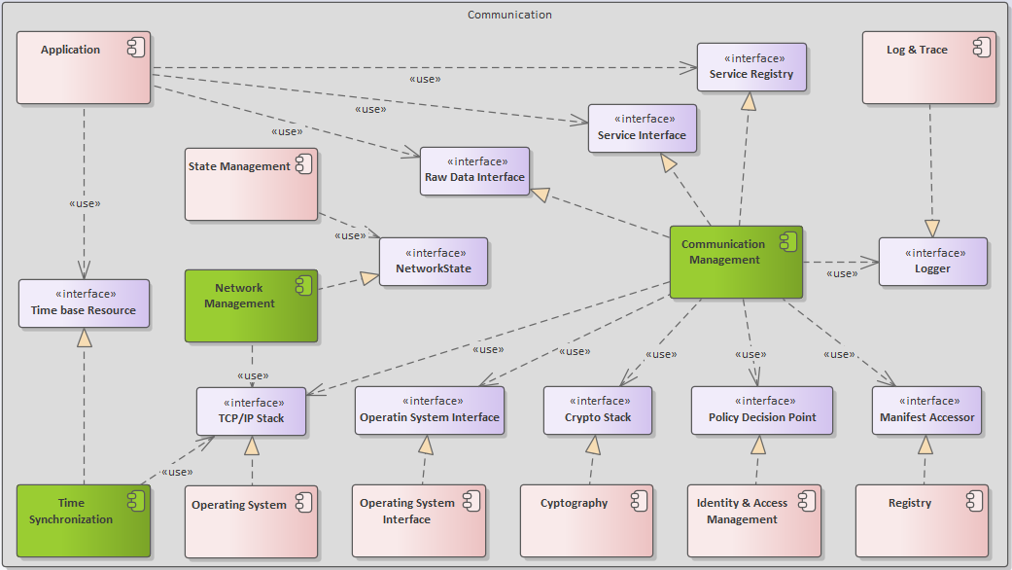
3. Autosar Adaptive platform - Architecture & Interface - Building block view - Communication
Notes:
CM: responsible for all levels of service-oriented and raw communication between applications in a distributed real-time embedded environment, provides functionality for reading and writing binary data streams over a network connection.
Service Interface: AA use for service-oriented communication.
Raw Data Interface: AA use to send and receive streams of raw data.
Service Registry: AA use to register and to discover services during runtime.
Logger: AA use to log textual messages.
TCP/IP Stack: used to control network connections for inter-machine communication.
Operating System Interface: used to control connections for intra- and inter-process communication.
Crypto Application Interface: used for end-to-end protection (integrity, authenticity, confidentiality) of communication channels.
Manifest Accessor: used to read service configuration from the Manifests.
Policy Decision Point: used to check access.
NM: provides functionality to request and query the network states for logical network handles, Such network handles can be mapped to physical or partial networks.
Network State: used to request and query the network states for logical network handles.
TCP/IP Stack: use to send or receive NM messages on the physical networks.
Time Synchronization: provides synchronized time information in distributed applications to be able to track events in time or to trigger them at an accurate point in time.
Time Base Resource: used retrieve and update time information.
TCP/IP Stack: used to perform synchronization via network.

Slide 15
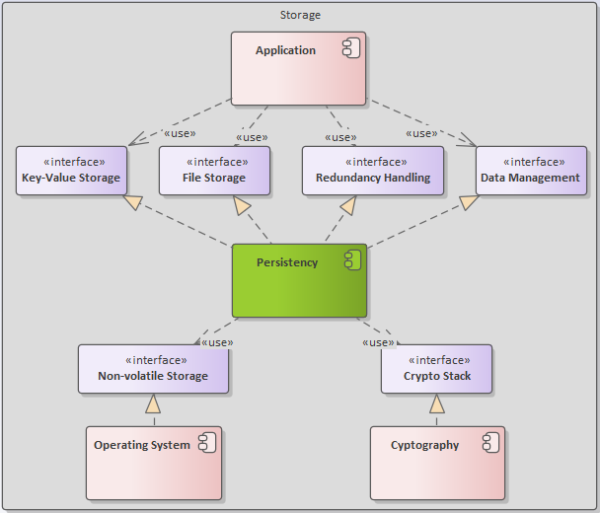
3. Autosar Adaptive platform - Architecture & Interface - Building block view - Storage
Notes:
Persistency provides functionality to store and access data.
Key-Value Storage: read and write access to data structured as key-value.
File Storage: read and write access to plain files.
Redundancy handling: redundant storage of data and files for error detection and correction schemes.
Data Management: trigger data migration and data reset.
Non-volatile Storage: access non-volatile storage.
Crypto Stack: ensure integrity and confidentiality of the stored data.

Slide 16
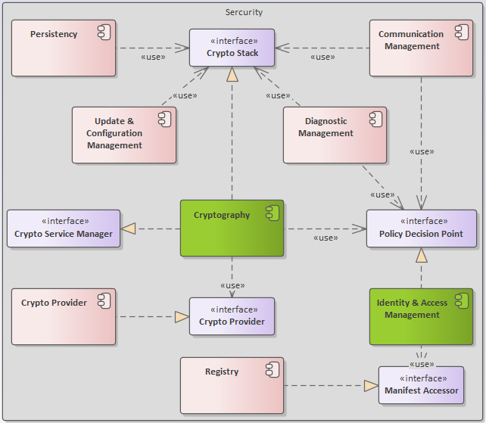
3. Autosar Adaptive platform - Architecture & Interface - Building block view - Security
Notes:
Cryptography provides various cryptographic routines to ensure confidentiality of data, to ensure integrity of data (e.g., using hashes), and auxiliary functions for example key management and random number generation
Crypto Stack: provides cryptographic routines and auxiliary functions.
Crypto Service Manager: provides internal functionality for access management and certificate storage.
Crypto Provider: access the actual implementation of cryptographic routines and auxiliary functions provided by external libraries or hardware drivers.
Policy Decision Point: check access
Identity & Access Management: checks access to resources
Policy Decision Point: make access control decisions
Manifest Accessor: used to access data stored in Manifests.

Slide 17
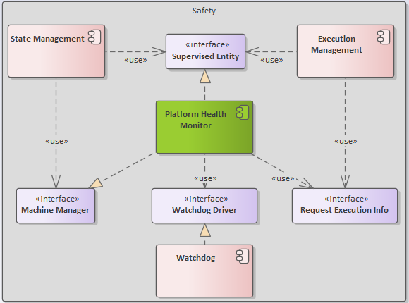
3. Autosar Adaptive platform - Architecture & Interface - Building block view - Safety
Notes:
Platform Health Management performs (aliveness, logical, and deadline) supervision of Processes in safety-critical setups and reports failures to State Management.
Machine Manager: trigger a reset of the Machine.
Supervised Entity: report Checkpoints to PHM.
Watchdog Driver: control the Watchdog.
Request Execution Info: retrieve information about active Processes and Function Group States and enable / disable its supervisions accordingly.

Slide 18
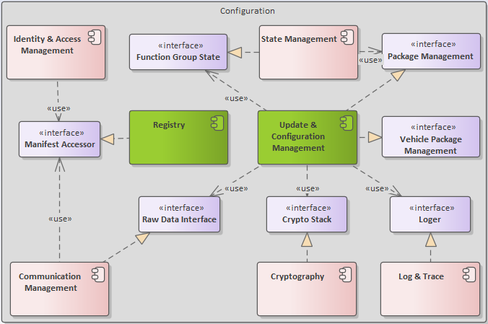
3. Autosar Adaptive platform - Architecture & Interface - Building block view - Configuration
Notes:
UCM: updating, installing, removing and keeping a record of the software on an AP in a safe and secure way, enables to update the software and its configuration flexibly through over-the-air updates (OTA).
Package Management: download, process, activate and remove Software Packages & provides the status of ongoing updates to SM.
Vehicle Package Management: functionality methods to download, process, activate and remove Vehicle Packages.
Raw Data Interface: use for raw data transfers.
Crypto Stack: check the integrity and authenticity of software packages.
Logger: write log messages.
Function Group State: bring ARA into a state that is safe before applying a software update.
Registry: provides access the information stored in Manifests.
Manifest Accessor: used to access data stored in Manifests.

Slide 19
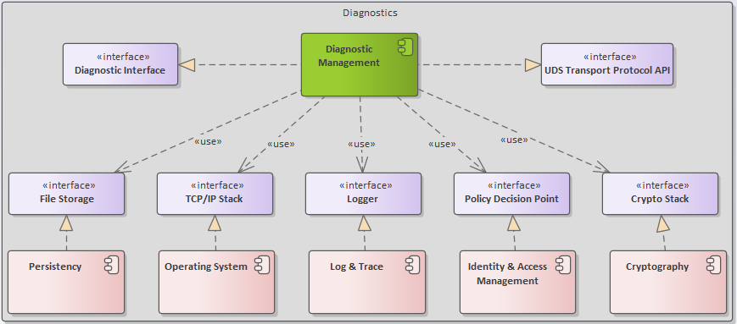
3. Autosar Adaptive platform - Architecture & Interface - Building block view - Diagnostics
Notes:
Diagnostic Management is responsible for handling diagnostic events produced by the individual Processes running in an ARA & provides access to diagnostic data for external Diagnostic Clients via standardized network protocols.
Diagnostic Interface: create diagnostic events and store them persistently.
UDS Transport Protocol API: extend the AP with UDS transport layer implementations.
File Storage: use to store diagnostic data persistently.
TCP/IP Stack: used to accept and control network connections from external Diagnostic Clients using the UDSonIP protocol.
Logger: log errors and diagnostic events.
Policy Decision Point: check access of Diagnostic Clients.
Crypto Stack: perform authentication of diagnostic sessions.

Slide 20
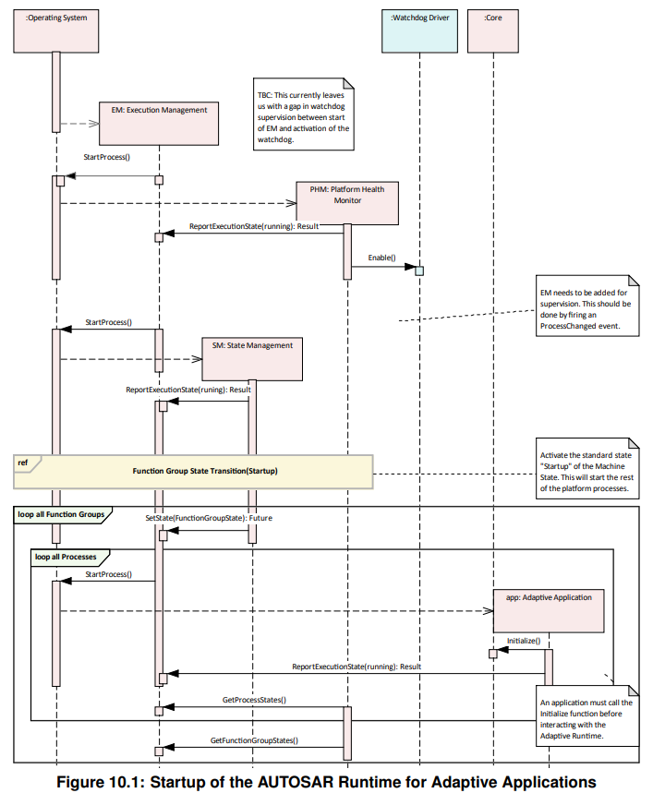
3. Autosar Adaptive platform - Architecture & Interface - Runtime view - Adaptive Applications lifecycle

Slide 21
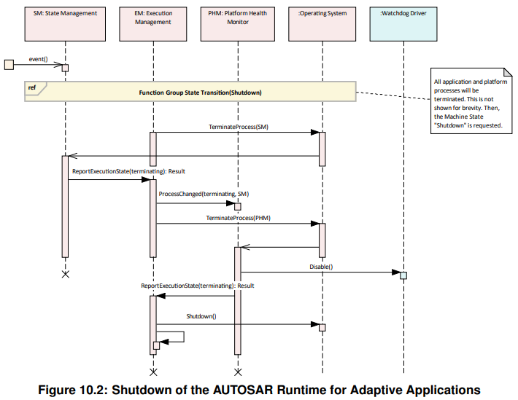
3. Autosar Adaptive platform - Architecture & Interface - Runtime view - Adaptive Applications lifecycle

Slide 22
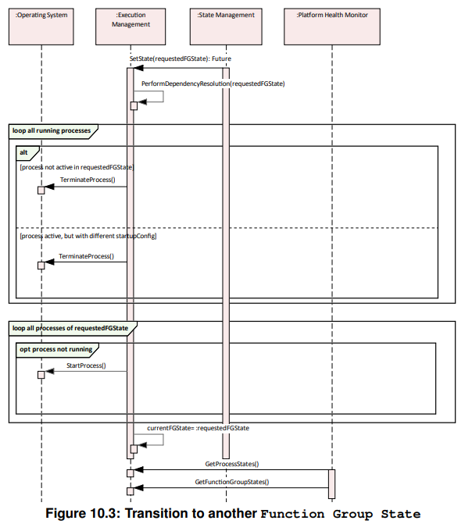
3. Autosar Adaptive platform - Architecture & Interface - Runtime view - Adaptive Applications lifecycle

Slide 23
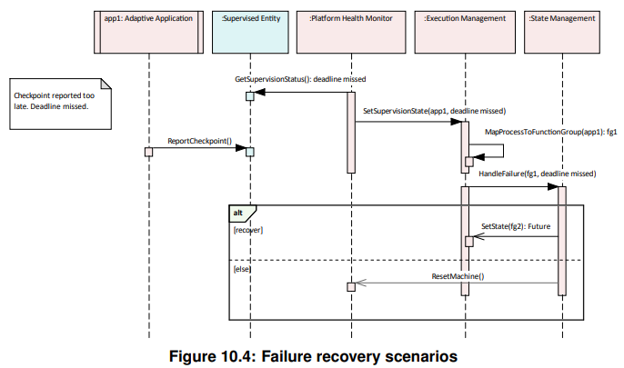
3. Autosar Adaptive platform - Architecture & Interface - Runtime view - Adaptive Applications lifecycle

Slide 24
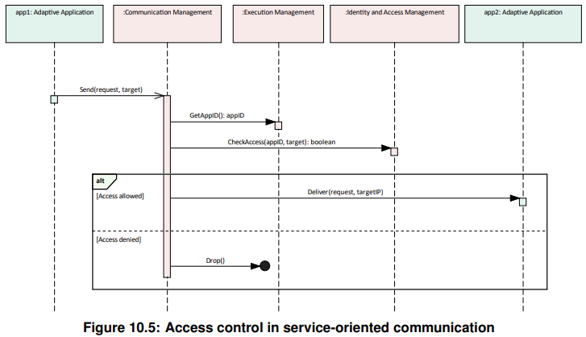
3. Autosar Adaptive platform - Architecture & Interface - Runtime view - Communication

Slide 25
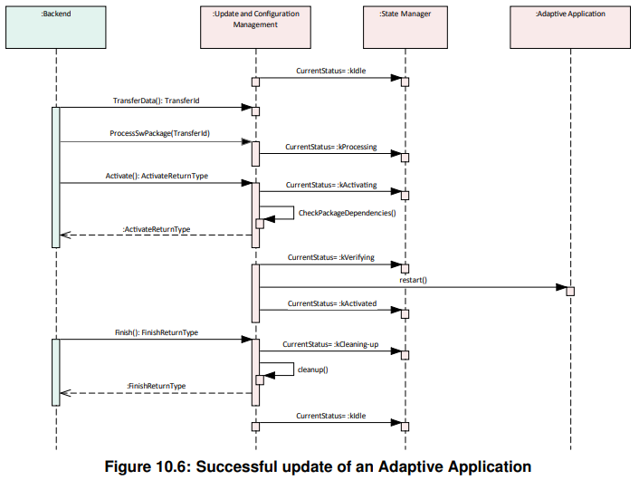
3. Autosar Adaptive platform - Architecture & Interface - Runtime view - UCM

Slide 26
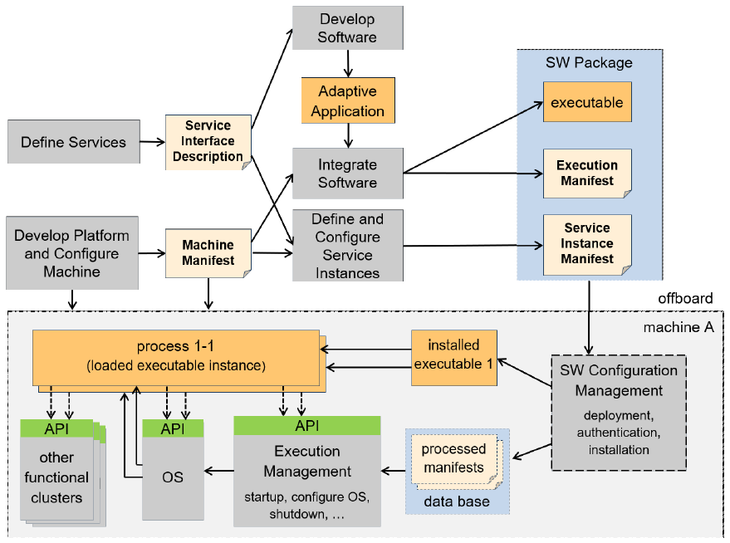
3. Autosar Adaptive platform - Methodology
Notes:
AP development workflow
Methodology involves the standardization of work products for the description of artifacts like services, applications, machines, and their configuration; and the respective tasks to define how these work products shall interact to achieve the exchange of design information for the various activities required for the development of products for the adaptive platform.
Execution Manifest : Describes deployment-related information of the application executed on the AUTOSAR AP.
Service Instance Manifest : Describes how service oriented communication will be configured (according to transport protocol).
Machine Manifest : Describes the configuration information of the machine where AUTOSAR AP is executed

Slide 27
Thank you for attending!

